Slide 1
Team Aadhya
Ideation Phase
THEME : Social Trends

Slide 2
Approach
Data collection using web scraping
R Studio
Merge data sets and generate dictionary of social media, countries and users
R studio
Build website and map the values on search to map that shows bar graph
Brackets
Social media stats
Data handling
Html and maps API
Website: https://gs.statcounter.com/social-media-stats/all/

Slide 3
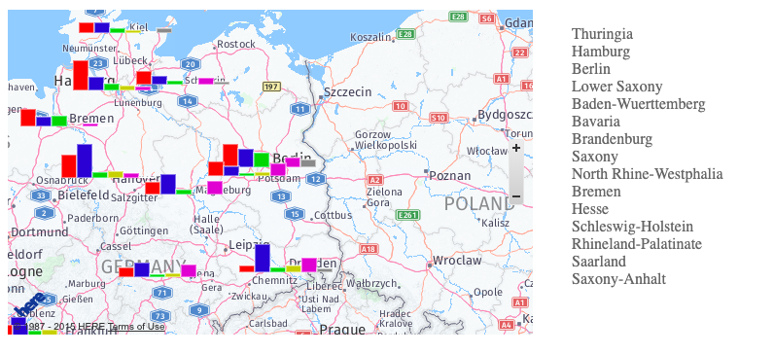
Web Interface
When city is clicked, the social media apps percentage of particular region will be shown in bar graph

Slide 4
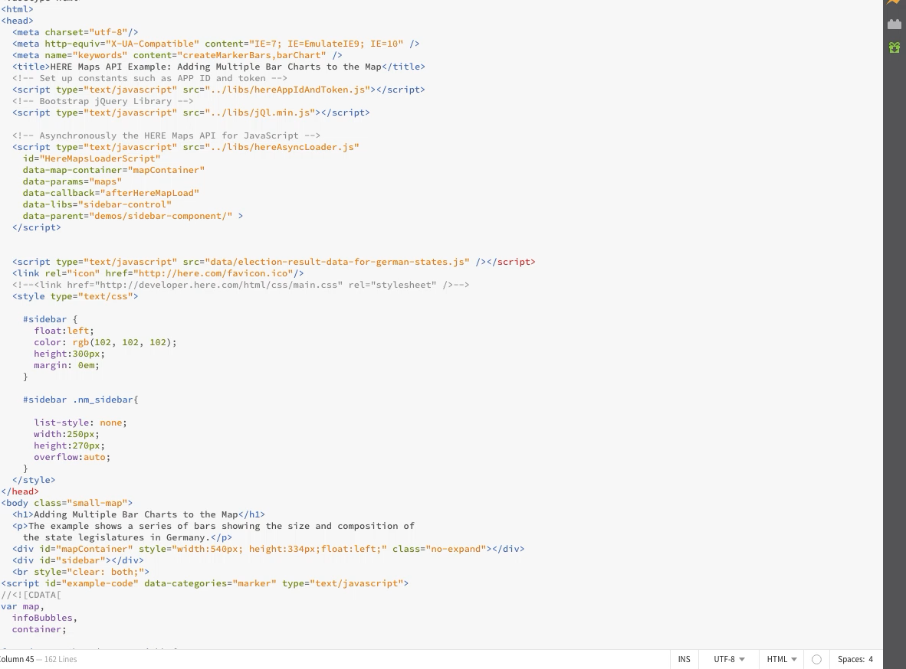
Work Progress
Testing
with
existing
Scenarios
video

